Slide 1
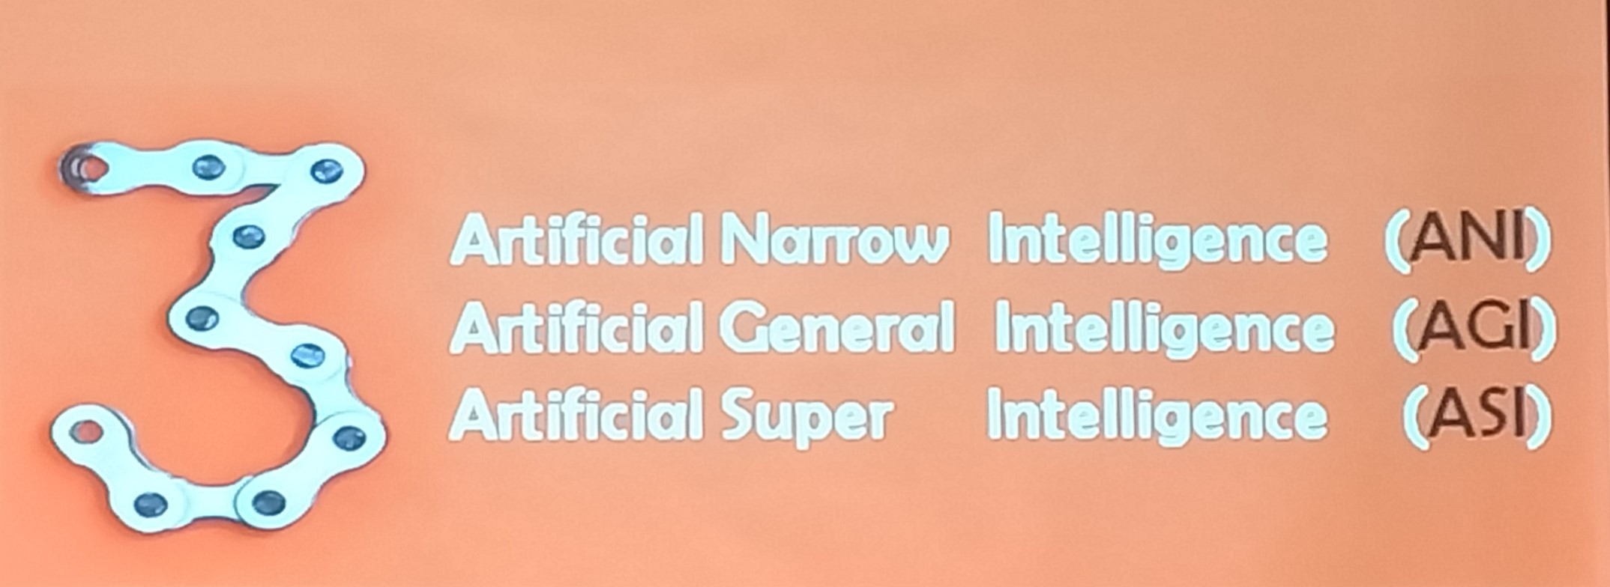

Slide 2
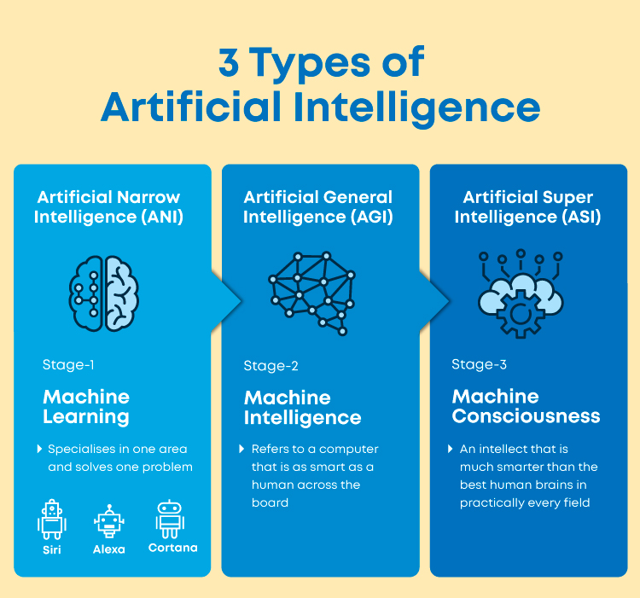

Slide 3

AI Movies

Slide 4
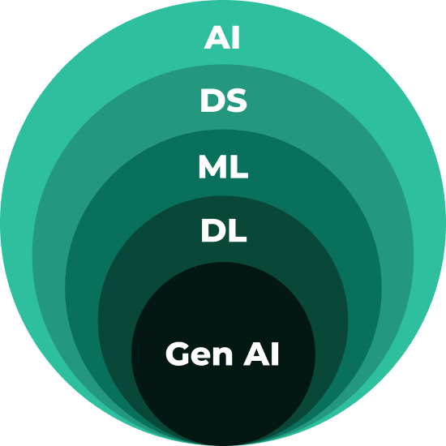
Stages of Artificial Intelligence
Artificial Intelligence (AI)
The capacity for machines to perform tasks that simulates human intelligence such as data processing, robotics and problem-solving.
Data Science (DS)
An approach to achieve AI that leverages or acts upon data. This includes statistics and general model building.
Machine Learning (ML)
ML trains models to identify and predict patterns based on human-processed data, rather than replying on hard-coded rules
Deep Learning (DL)
DL is a powerful and advanced ML paradigm that leverages neural network models to improve model performance without feature engineering.
Generative AI (Gen AI)
Gen AI is a highly sophisticated subset of AI using large parameter models to create data across a variety of modalities.
*GenAI is still growing and boundaries are still open to discover!

Slide 5

Data Mining!!!

Slide 6
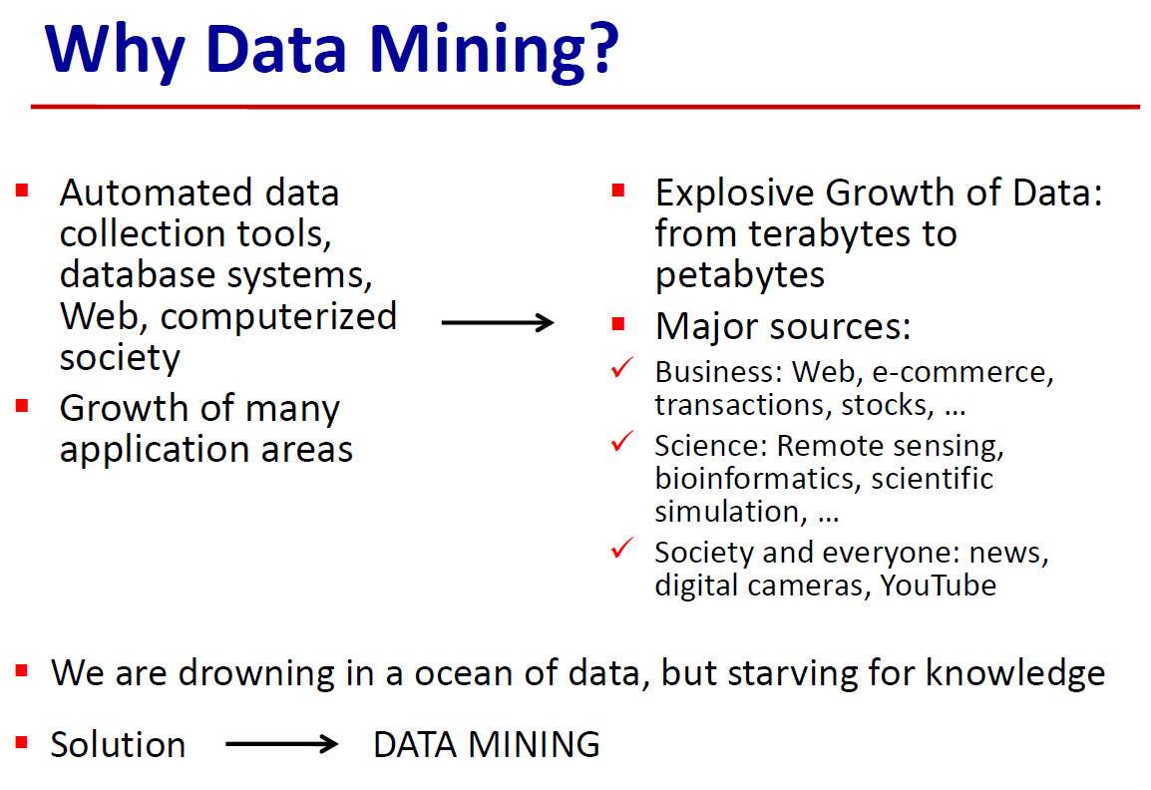

Slide 7
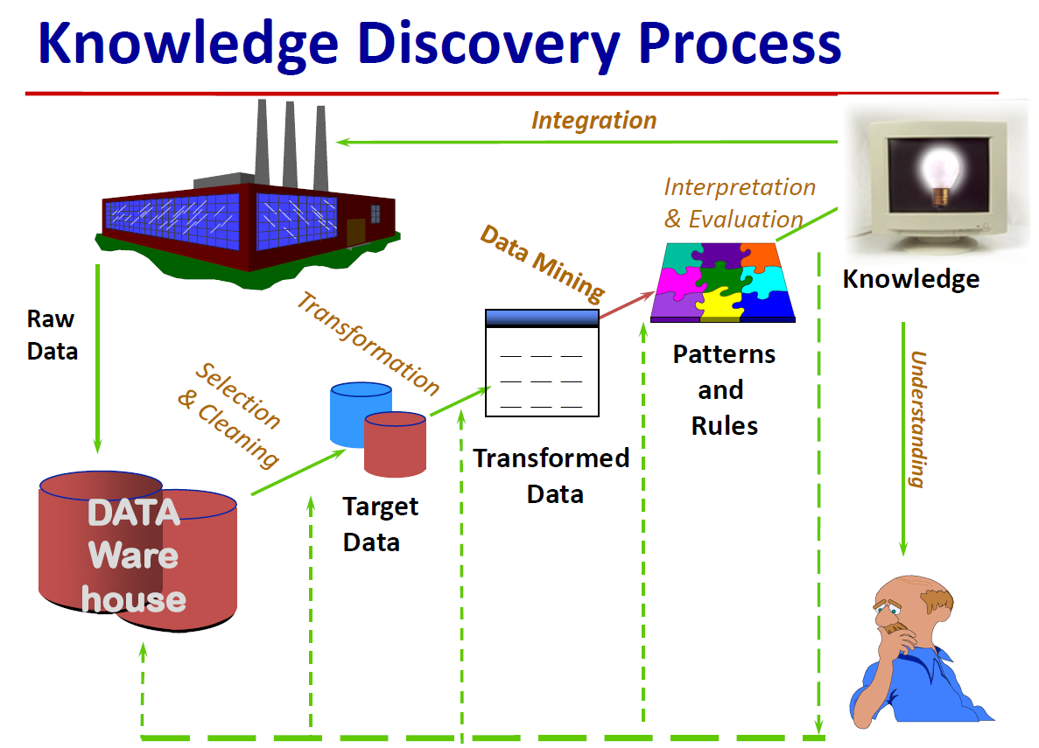

Slide 8
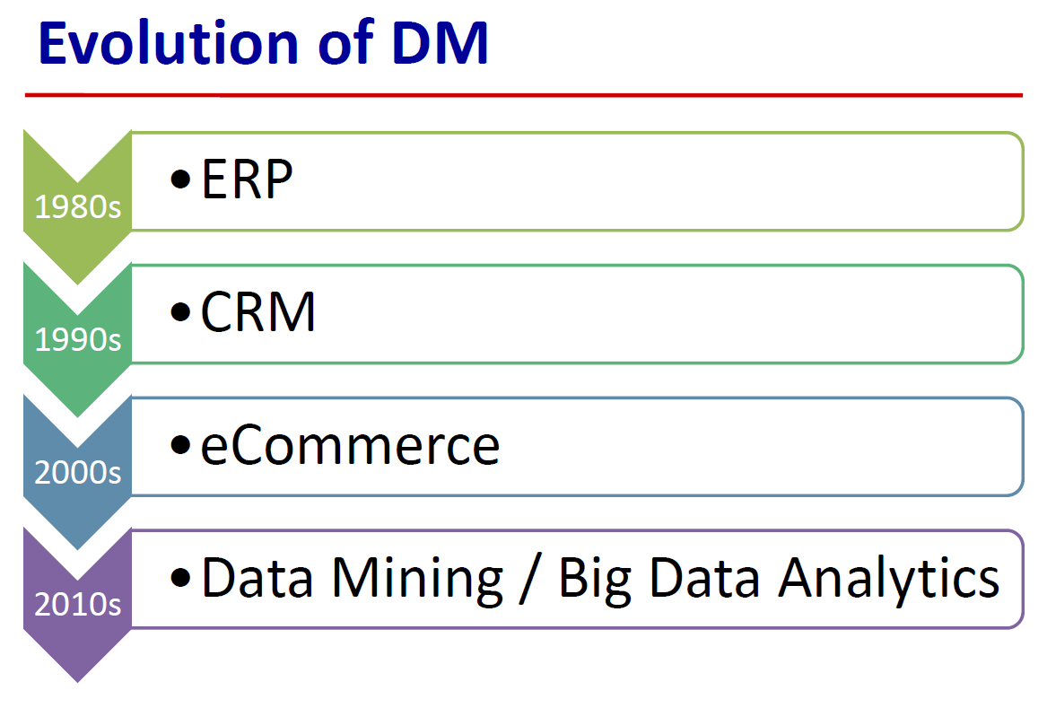

Slide 9
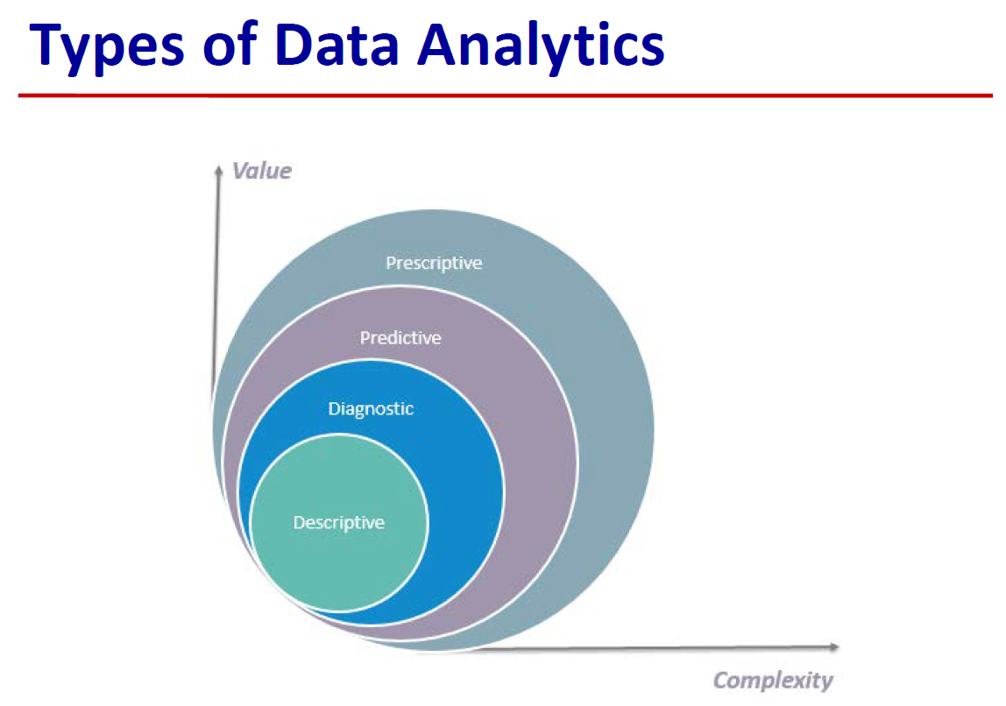
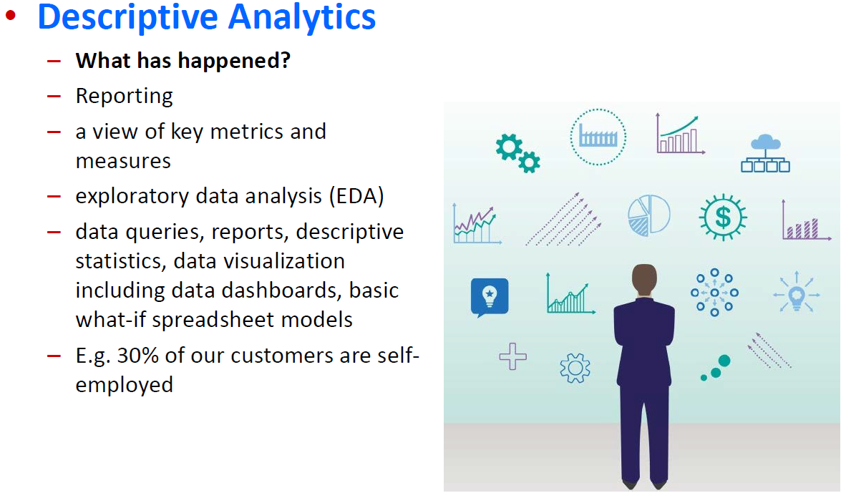
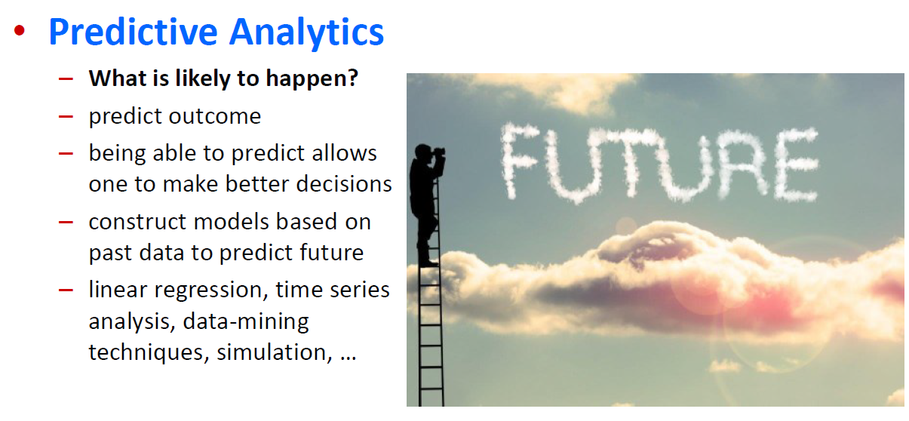
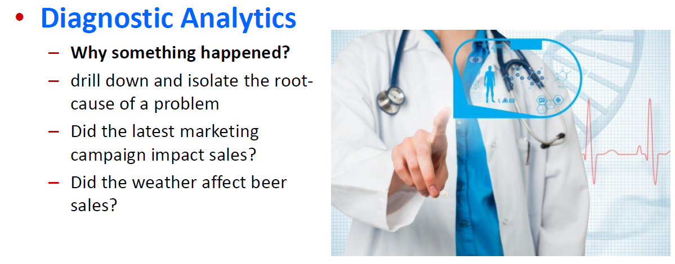
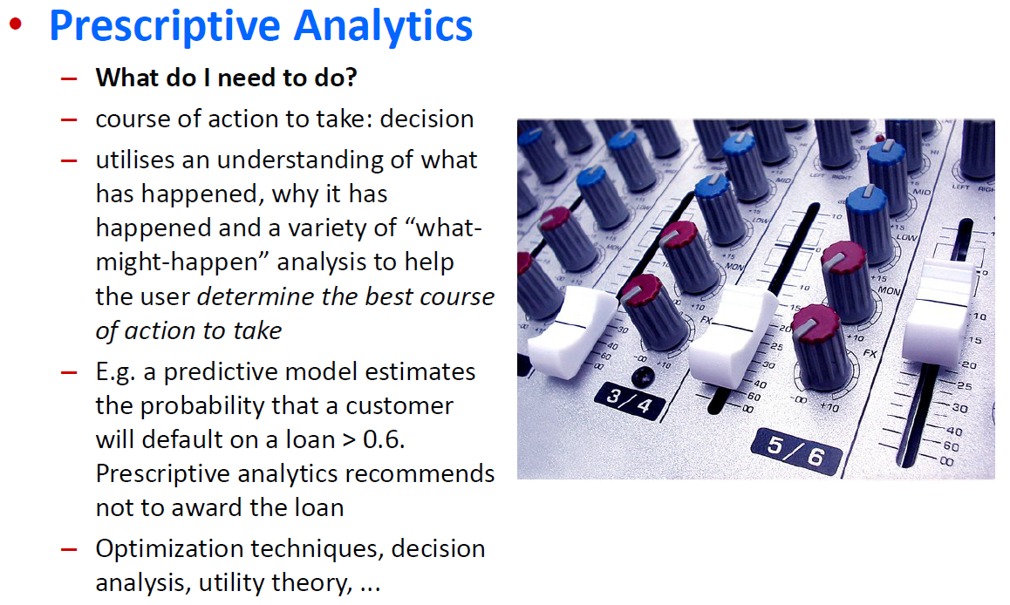

Slide 10
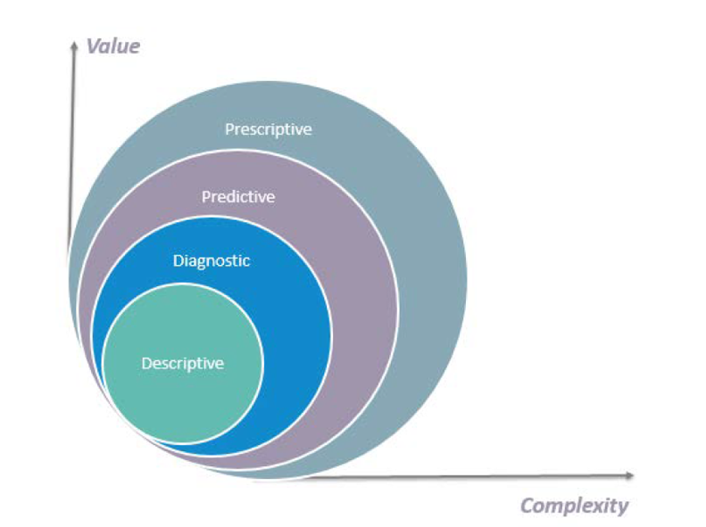

Slide 11
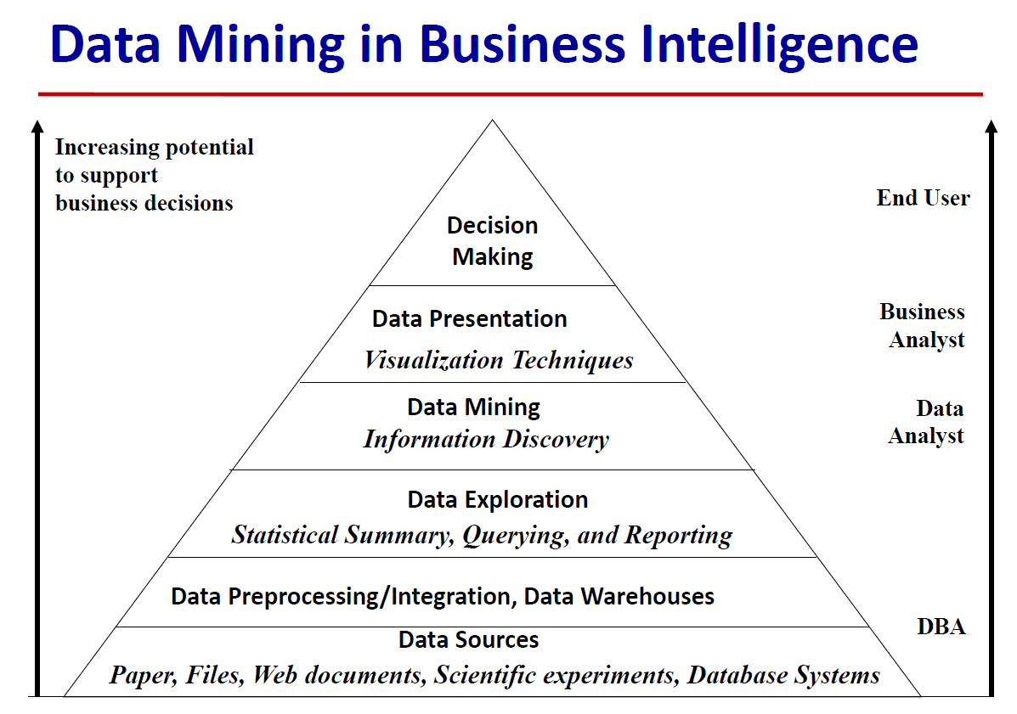

Slide 12

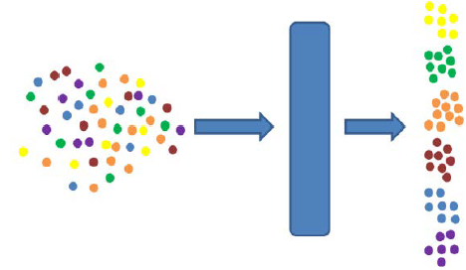
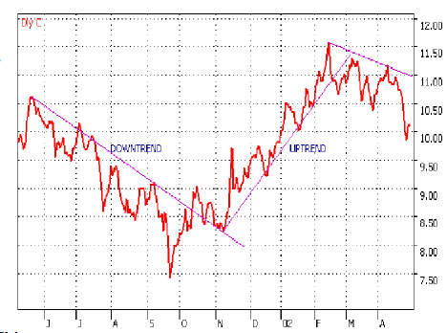
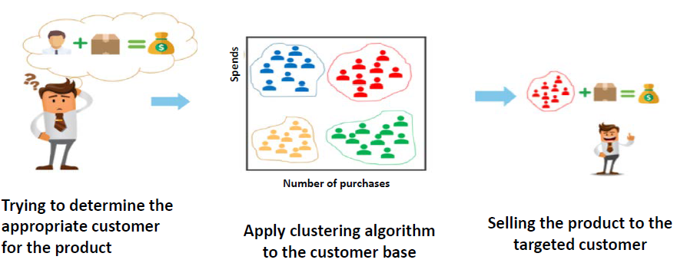
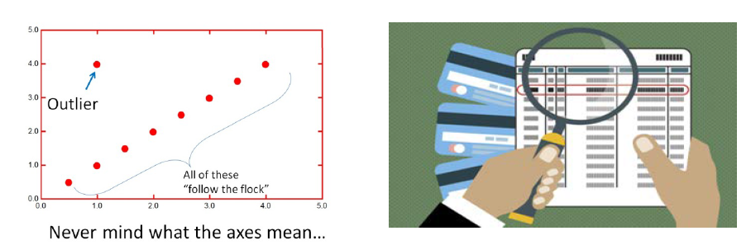
Industrial Use Cases of Data Science
Mining Frequent Patterns, Associations, and Correlations
Trend and evolution analysis
Classification and Prediction
Cluster analysis
Outlier analysis

Slide 13
